Slide 1
2013 Library Website User Survey
Phase 1 of the Website Usability Study conducted by
Helena College Library for FY13.
Results compiled by Elizabeth Karr
May 7, 2013

Slide 2
Background Information
The first phase of Helena College Library’s Website usability study involved gathering user community feedback via an online survey.
The survey was designed by library staff and formatted for online dissemination by Marketing & Communication Coordinator, Barb McAlmond. McAlmond had voiced access to a Helena College-approved survey program that the library chose to use.
The survey was accessible online via the Library Website from April 3 through 26, 20-13.
Advertising for the survey was offered through in-house library print signs, reminders on the Library’s Facebook page, introduction and reminders through the biweekly Helena College e-newsletter and a mass UMHelena email to all faculty, staff and students.

Slide 3
User Feedback: Summary
Most users stated that the Website was overly complicated in that: the organizational structure was hard-to-grasp; different links led (unnecessarily/confusingly) to the same resource; and, the amount of content was overwhelming.
Users recommended a more user-friendly design where: organization is intuitive and self-explanatory (esp. important as many survey participants never visited the physical library for assistance and the several survey participants who stated they were “technologically-challenged”); there are less clicks to get to desired materials (i.e. the journals they want to search); and, the layout is more simple and streamlined.
Electronic databases/journals were the most accessed specific resource on the Website as well as stated to be the most difficult resource to find, access, and then use.

Slide 4
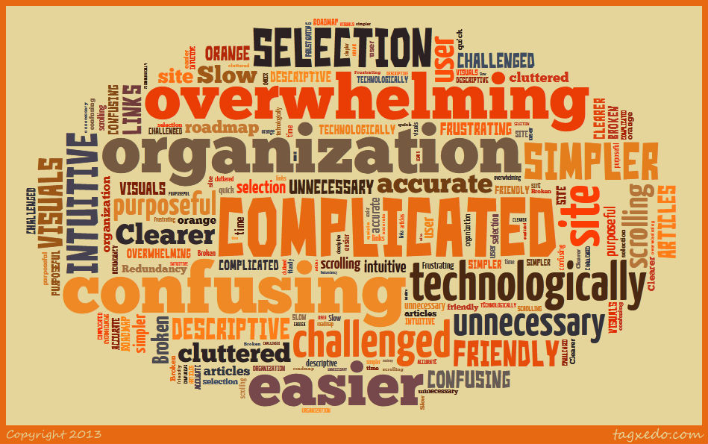
User Feedback: Criticisms

Slide 5
Survey Results
Survey Questions and user answers and comments

Slide 6
1. Are you a
Student – 73/84
Faculty member – 6/84
Staff member – 5/84
No Responses - 0
Total participants who took the survey (completely or partially) = 84

Slide 7
2. How often do you use the Helena College Library website?
Daily – 10/84
Weekly – 27/84
Monthly – 32/84
Not at all – 15/84
No responses - 0

Slide 8
2. How often do you use the Helena College Library website?
Usually to find out availability of book or video.
I love the access we have to e-books and journals for the papers I have had to write!
Excellent site, I always find exactly what I'm looking for.
Only when needed for class
I use it for research papers in my various classes.
I use the computers monday thru friday to complete all my internet and computer assignments. Once in while I check out a book wish I had time for more with such a selection.
I search databases fequently for peer reviewed PDF journal articles. The online library system allows me to quickly narrow my search parameters, thus saves me time.
Monthly to weekly
The library website is easy and very helpful when I am looking for a good book to read or writing a paper.
Thre is so much in formation I love how easy it is to use.
Except for last semester I found no need to be in the library.
Depends on class I'm taking. Sometimes I use the website every day.
I use the HC Library website for research.
Since I do not use the website why is it mandatory to answer the rest of these questions?
This semester there's no need for me to.
A whole lot in spurts
for color printing, research

Slide 9
3. How would you rate the overall look of the website?
Very appealing - 14/84
Appealing – 56/84
Slightly appealing – 10/84
Not at all appealing – 4/84
No Responses - 0

Slide 10
3. How would you rate the overall look of the website?
The "Woodsy Owl" looks better suited to a children's library.
I think it's a little confusing to navigate. There are a lot of links to get to the same essential information.
The website is easy to read and takes me where I want to go.
It is a menacing color..way to much orange. Hard to see. And composed to be confusing to the average person.
It can be a slow when returning search results.

Slide 11
4. How easy is it to navigate the library website?
Very easy – 9/84
Easy – 37/84
Slightly easy – 30/84
Not at all easy – 7/84
No Responses - 1

Slide 12
4. How easy is it to navigate the library website?
some of the pages are dead links. Also, I think it would be better if there were fewer Helena College links on the Library home page. Let the page be primarily, almost entirely, about the Library. Just give a prominent link to return to the Helena College homepage.
kind of hard to navigate
It took me a while to learn how to navigate to the pages I wanted. It sometimes felt difficult to get going in the right direction but the library staf was really helpful in reminding me how to get where I was going!
The website isn't very self-explanitory, but it IS quite easy to navigate after it is explained a bit. I think that every student should experience the librarian visit to class where the website and database use is explained and reviewed. I have sat through Elizabeths presentation of the website twice in classes and she does an awesome job of explaining how to use it! :)
It can still be really confusing for me to do research and to be able to use the resources that were available, even after I had a Librarian help me with using the site.
If the organization could be simplified, it might be easier to find what you're looking for. The resources available and researching topics is complicated, and a simpler entry might be easier to learn.
You have to give a class to use this site. Journals take forever to search for. Its ridiculous.
The main portion is okay, but trying to figure out what search area to use is confusing. Also, it takes a few clicks to get to the area that tells you waht each area is for, and it's a little unclear.
The search engines are confusing and difficult on Ebsco but I don't think that is the library's fault.
I am not a great web navigator.

Slide 13
5. How often are you able to find the information you need without help?
Very often – 19/84
Often – 43/84
Slightly often – 18/84
Never – 3/84
No Responses - 1

Slide 14
5. How often are you able to find the information you need without help?
The systems for looking up journal articles could use a lot of improvement. Many of the articles are locked, or are difficult to access. There should also be more choices for the types of articles being searched, such as if a student specifically is looking for peer-review articles.
The HC-UM library staff have been valuable time savers who help me discover faster ways to search as well as do a little bit of the work for me. I have used the librarians along with the web site several times and recommend them to other students.
Thanks to a little instruction on how to effectively use the sight.
So confusing, you think that you are going to one website, then you find yourself confused and forgetting how to find the resources that you are looking for.
Its not an easy site to search.
When I am not finding what I need I ask for help.
This year I'm searching Human Resource topics, I've just been using the business areas... but haven't always found what I'm looking for

Slide 15
6. How much time has it taken to find the information you need?
Very long time – 3/84
Long time – 11/84
Slightly long time – 42/84
Not very much time – 27/84
No Responses – 1/84

Slide 16
6. How much time has it taken to find the information you need?
depends on the subject
Especially in the library. I gave up using it.
If I can't find what I need the first few tries, I just go to google and look for a credible source.

Slide 17
7. Are you comfortable contacting the librarians when you need help finding information on the website?
Very comfortable – 52/84
Comfortable – 24/84
Slightly comfortable – 5/84
Not at all comfortable – 3/84
No Responses - 0

Slide 18
7. Are you comfortable contacting the librarians when you need help finding information on the website?
I just go up to the library and ask about information.
I went into the library last Thursday afternoon and got a lot of help finding the books I needed!
I never use the library
All the librarians are very helpful and more then willing to help. Not sure how I would have made it through this semester without Elizabeth Carr :) She has helped me tons and never makes me feel stupid when I don't have a clue what I'm doing. All the library staff does a great job!!
They are amazing people always willing to help in any way they can
Librarians Rock! Thanks Ladies!!
The librarians are exceptional.
They are kind of rude
They are so friendly and full of knowledge.
Not the librarians fault for my lack of comfort. I just want to not use a resource if I don't have to.
I don't ever go into the library in person, just remote.
I do not use the website
They have all been very polite and helpful when I have needed help. Willing to spend time with me to make sure I understood what was discussed.

Slide 19
8. Where are you when you access the library website? Check all that apply.
Off campus – 63/83
In the library – 45/83
Elsewhere on campus – 41/83
In Moodle - 31/83
1 person stated on their phone; a user queried if an app would be made; and someone stated that “moodle is not easy for me as sometimes it kicks you out of it.”

Slide 20
9. What do you access most often from the website?
Journal databases – 54/84
Resource guides – 13/84
Reference help (via phone, email or chat) – 5/84
Books in the catalog – 11/84
No Responses – 1/84
Videos added in “other” section, 3 people say they never access the Website, and 1 person stated they access all resources

Slide 21
10. Have you? (Check all that apply)
Taken the Library Research Tutorial – 37/84
Taken other tutorials – 23/84
Used a database to find journal articles for research – 64/84
Used the online forms to request something – 15/84
Used the "Resource Guides" or "Databases by Subject" in your research – 56/84
Used the library catalog – 38/84
Used the Research Wiseguide – 15/84

Slide 22
11. Suggestions that would make the library website more useful and/or usable.
i think you're doing a pretty good job to be honest but you need more fiction like david levitha and john green and stuff like that :]
Researching something from the site is complicated!
One of my complaints about websites is that I just get comfortable with how to use a page when the page gets re-organized. Things aren't where they used to be. This has happened to the Lib site over the last few years.As a result, I occasionally misdirect students.

Slide 23
11. Suggestions that would make the library website more useful and/or usable.
not having to narrow your search so many times
Maybe have a computer at your front desk (or elsewhere in the library) that is automtically "rotating" through the website so students recognize it when they are in the library and stop to look and ask questions. Visuals seem to attract students and help them learn the resources available. Asking them to take time to learn to navigate it on their own isn't as appealing as "experimenting" with it right there in the library.

Slide 24
11. Suggestions that would make the library website more useful and/or usable.
I think for people like me who are familiar with computers, but using the resources that are available, it would be nice for a user friendly website, that would be more effective for choosing websites that would best to suit the people who are trying to do papers. I guess I need to write more papers in order for me to understand the process of resources here? Just saying...
A different method of organizing the research guides would be useful. I can never find anything using this tool

Slide 25
11. Suggestions that would make the library website more useful and/or usable.
I think that the website is great. I just get lost looking for my topic. I do feel that the librarians are available and willing to help me find what I am looking for.
Generally the website is easy to use. I think the links on the main page could be easier to find/use (maybe larger font, sorted differently, etc.) It might be beneficial to clean out some of the journal links - not all of them are linked to information that can be used for research.
[Use it] Still with no real success.

Slide 26
11. Suggestions that would make the library website more useful and/or usable.
As stated earlier, a simplified structure would be easier for me to find my way around. Maybe something like a visual graphic with links would be easier to understand at first encounter. Currently, it seems like there are many many ways to get to the same place, which makes it harder for me to get the big picture of where to go and what I've already looked at. It can be a little confusing, which is frustrating when under a time constraint for a class.

Slide 27
11. Suggestions that would make the library website more useful and/or usable.
Maybe copy a more easily accessable library structure from somewhere else? This site is too frustrating to use.
It is real groovy, just a little cluttered.
Make it more clear as to what online databases are available, and what types of things they'll return for you.
I would update the webpage and make it more 'dummy' proof. It is sort of difficult to navigate, especially if it is a first time user doing this.

Slide 28
11. Suggestions that would make the library website more useful and/or usable.
Perhaps using a larger variety of colors would appeal to me. The large splashes of orange tend to distract from resource links. The library page does not appear very different from the home page. I understand that is likely intentional, however the large margins force more scrolling than is necessary.
Would like to see things easier for students as myself older and not so computer literate.

Slide 29
11. Suggestions that would make the library website more useful and/or usable.
Make the "starred" journal recourses the top of the lists so we don't have to remember which one is best?
Make an easier path for the technologically challenged. So much is available it overwhelms
Maybe a clickable "How to" or kind of road map that led you along useful passages of information that were specific to different types of research. Possibly catagorized by desired depth of research material.

